Slide 1
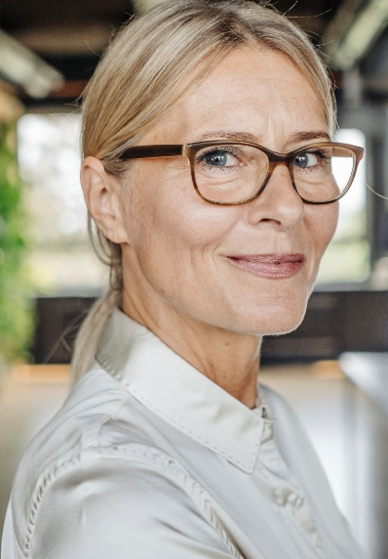

Patricia Jones
Name
Age
53
Employment
NHS Manager
Personality keywords
Patricia has been an NHS Manager for 21 years.
She attends regular meetings every morning & monitors changes in the COVID data.
Patricia would like the data to be in a graphical form showing predictions that can be easily presented at the Management Meetings.
Biog
Goals
Personal motivations
Career progression
Social motivations
Increase popularity & use graphs as a discussion point
Financial motivations
Promotion
Extrovert
Intuitive
Thinking
Judging
Image
Display the data in a format that can be used for predictions and presented easily at meetings.
Represent the data in a way that cannot be easily interpreted.
We must:
We must not:
Phone
Tablet
Laptop
Desktop
Social net

